Slide 1
LG Strategic Partnership Overview
March 19, 2014
Presented By:
Edward Hagans, Senior Director
WidePoint Corporation

Slide 2
Agenda
Introductions
WidePoint Overview
Partnership Opportunities
WidePoint Cybersecurity
WidePoint Managed Mobility Services
Why Partner with WidePoint
Demonstration
Q&A
Next Steps

Slide 3
Introduction of WidePoint Team
Edward Hagans - Senior Director
Dave Russie – Senior Vice President(SVP)
Daniel Turissini – Chief Technology Officer(CTO)
John Atkinson – Chief Sales & Marketing Officer(CSMO)
Denise Finnance – President/COO, Cybersecurity
Notes:
EDDIE

Slide 4
WidePoint Overview
John Atkinson, CSMO

Slide 5
WidePoint Corporate Overview
WidePoint Corporation
  Public Company
    NYSE: WYY
    Founded 1998
  Employees 200+
  HQ: McLean, VA
Notable Press Releases
  WidePoint Completes $12.Million Public Offering
  WidePoint Launches “Certificate on Chip/Device” for Mobile Device Security
  WidePoint Awarded $600 Million Blanket Purchase Agreement by Department of Homeland Security
  WidePoint Enters Into Global Master Services Agreement with Compass Group
  WidePoint Awarded MMS contract for Center for Disease Control & Prevention(CDC) and Federal Communication Commission(FCC)
WidePoint Solutions
  MMS(Managed Mobility Services)
    Cyber Security
      Federated E-Authentication
      Identity Management
      PIVital ID
    TLM (Telecom Lifecycle Management)
      Telecom Expense Management (Wireless/Wireline)
      Procurement Portal
      24/7/365 Help Desk
Key Markets
  Government (Federal, State, Local)
    DoD
    Civilian including GSA, DHS,CDC, FCC, ATF
  Enterprise
    HealthCare, Education, Manufacturing, Retail, Financial, Defense Contractors, Aerospace

Slide 6



















WidePoint Customers
34 of Fortune 100 Companies
22 of Top 25 Federal Contractors
200+ Colleges & Universities

Slide 7
















WidePoint Customers Cont.
Numerous Government Agencies
100+ Healthcare Organizations
40+ Banks & Financial Institutions
11 Airlines
7

Slide 8
Telecom Lifecycle Management(TLM)
Dave Russie, SVP
Serving The Mobile Needs of a Global Workforce. Always supported, always productive.

Slide 9

WidePoint’s Telecom Lifecycle Management Solutions
Complete and secure solution for both mobile and landline management, customized to enforce your policies, ensure contract compliance and provide visibility for all telecom assets and services while maximizing your telecommunications budget
  COMPLETE TELECOM LIFECYCLE MANAGEMENT (Wireless/Wireline)
    Order management
    Asset and logistics management(Kitting /Staging)
    Invoice audit and management services
    Policy enforcement
    Cost optimization
    Technical refresh and device end of life management
  TELECOM EXPENCE MANAGEMENT
    Comprehensive expense management reduces costs while supporting your organization’s needs and policies.
  TELECOM LIFECYCLE MANAGEMENT PORTAL
    Customized for your needs, ensures savings, optimizes assets, and maximizes budget.
  24/7/265 HELP DESK SUPPORT
    Our state-of-the-art call centers are available 24/7 to help your users stay productive.
Internal Use Cases for LG
  Wireless
    Corporate Liable
    BYOD
  Wireline

Slide 10
Cybersecurity
Dan Turissini, CTO
Denise Finnance, President/COO, Cybersecurity
Conquering Cyber Threats. Who’s really behind that username.

Slide 11

WidePoint Cybersecurity Solutions
  Federated E-Authentication
    Cross-domain access management gives users proper access to resources across multiple sites.
  Identity Management
    Trusted digital identities for e-commerce, online banking, and Internet-based enterprise applications
  PIVotal ID
    Approved by the Federal Bridge and the DoD as an approved PIV-I provider.
  Access Management and Data Protection
    Give your users proper access and permissions regardless of what device they’re using or where they are.
  Digital Certificates and Credentials (Cert on Device)
    ECA and ACES digital certificates for conducting business with the government and access to online services.
WidePoint is “Trusted”
Notes:
WidePoint’s Cybersecurity solutions address access to multi-level secure resources and message traffic based on entity identity, roles, and privileges. WP’s federated solutions support various strong electronic identity credentials that can be readily electronically validated by any logical/physical access point.

Slide 12
Federated Identity for Cybersecurity
Federated identity provides a strong, biometrically enabled electronic identity credential, that can be readily electronically validated by any Federal logical/physical access point that allows the decision maker or databases to make a local specific privilege and/or authorized ACCESS decision confident in:
  The identity of the person attempting access;
  The identity of the device attempting access;
  The identity of vetted organization that they represent;
  That the organization and the individual have a legal relationship to do business with the federal government; and,
  That the individual has been vetted in person and has undergone a background investigation consistent with defined levels.
Credential assures you are who you say you are,
confirm what holder is permitted to access!

Slide 13
WidePoint’s Federal Cross-Certifications
Citi - PIV-I from CertiPath
Citizen to Government CAs
Bridge to Bridge
DoD PKI
ORC
GSA
ACES
ORC
HID - PIV-I from CertiPath
Verisign
USPS
GSA ACES
Identrust
Wells Fargo
State of
Illinois
Johnson & Johnson
Identrust
Bio
Pharma
Bridge
Cybertrust
ORC
Boeing
Verisign
Root 2
CertiPath
Bridge
DoD ECA
Lockheed Martin
ORC Engineering
Identrust
Northrop Grumman
Root 1
PIV-I NFI
ARINC
ORC
Raytheon
SETA
Subordinate
CAs
Root 1
FBCA
Bridge
Verisign
CertiPath Root
Exostar
Entrust
EACS
Verizon
Interoperability
Root
Shared Service Providers
Common Policy
Root
ORC
Subordinate
CAs
Root 2
Verisign
Entrust
DoD CCEB
Exostar
Identrust
Government Legacy CAs
JK MOD
PKI Root
DHS TWIC
Root
GPO
DHS
DOJ
USPTO
DOS
NASA
Treasury
UK MOD
PKI Root
CA 1
CA 2
Notes:
We are aware that our customers do not want to be locked in with proprietary technology
Work with all HSM providers, Thalyes, SafeNet
Release 6 supports various databases
Small projects and very large projects
Supports multiple issuers including the addition of new issuers after install and configuration
13

Slide 14
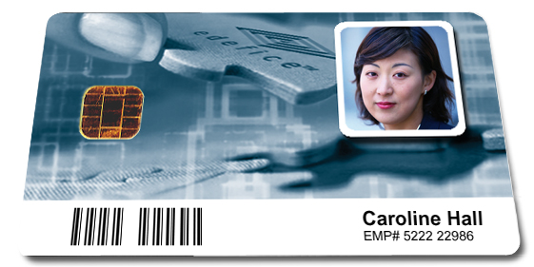








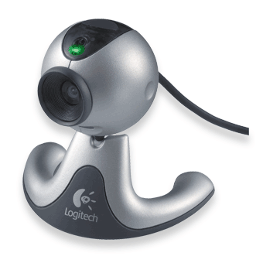

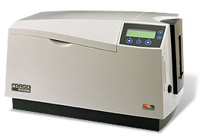
WidePoint’s Cybersecurity - Managing People, Devices, Data & Policy
Consolidate multiple Credentials onto a single
multi-functional device.
Password
Smart cards
Networks
?
Directories
Certificates
USB Token
Certificate Authorities
People
HR Systems
OTP Tokens
OTP Servers
Work
Biometrics
1135624
Provisioning / Metadirectory
OTP
Cameras
Physical Access
Printers
Reduced Sign On
Photo
Notes:
This slide can be used to further explain the role that RSA Card Manager provides.

Slide 15




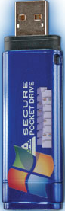
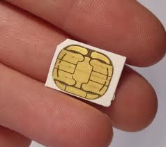
Device as an Identity Token
Removable HW Crypto
SD/MicroSD
USB
SIM
Embedded HW Crypto
Token

Slide 16
Multi-use Credential
Enable options
  Multi-App – PIVotal IDTM, EMV → New cards and/or add applications
  Multi-Use – Payments, ID → Cross issuer trust
  Mobile
Solution components
  WidePoint partner provides cross issuer trust & provides web widgets & readers (e.g., Intel Ultrabooks, smart phones)
  ORC issues credentials & provides cross certification for global trust
  Bell ID issues & manages payment & ID apps on cards & smart phones

Slide 17

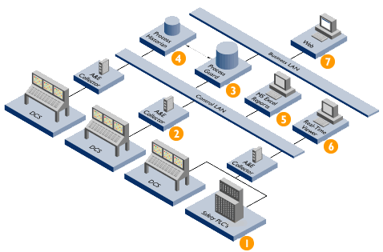

Current Markets Fueled by Government Mandate for Increased Assurance Levels
Government Security Standards will be Driven Across
the Business Continuum
Government Mandated Regulations
End User Applications Mass Markets
Government Contracting Ecosystem
Enterprise Marketplace
Millions of Users, Servers, Workstations
and Handheld Devices
Tens of Millions of Users, Servers, Workstations
and Handheld Devices
Global interoperability &
Unlimited Computer Resources

Slide 18
Market Opportunity
Current U.S. & U.S. Trading Partners
Program | Current Users | Potential User Community
TWIC/ TTAC | 2.5M | 40 Million DHS
ECA/ FiXs/ ACES/ NFI PIV-I | 250K | 3+ Million Contractor 2+ Million Foreign Trading Partners 40+ Million Dependent/ Veterans
Device IDs | 12K | 25 Million DISA 100+ Million Commercial
Public Safety | 7K | 25 Million APCO
Health Care | 2K | 60 Million Medicare/ Medicaid
E-Citizen/ Financial Institution [Social Network] | 250K | 100+ Million
Evaluating Non-US Markets

Slide 19
WidePoint/LG Partnership
Edward Hagans, Senior Director

Slide 20
WidePoint/LG Strategic Partnership
WidePoint/LG Strategic Partnership
  MMS(Managed Mobility Solutions)
    TLM
    Cyber Security
WidePoint Partner with LG teams
    Internal LG Uses Cases
      WP TLM Solutions for LG
        Wireless and/or Wireline
      WP Cyber Security for LG
        Employees / Partners
        Product Enhancement(Cert on Device)
    LG Enterprise/Government Sales Teams
      Promote/Co-Sell LG devices in conjunction with WP Cyber Security &TLM solutions sets
      Teaming/Collaboration with LG Enterprise & Government teams on opportunities
      Participate at LG device launches, carrier events, customer meetings, L&L, WebEx, etc.
      Collaborate on GSA opportunities
    Collaborate/Create WP “Bundled Offering” with LG devices
      “One-Off” deals
      Fixed price bundle
Cyber Security and MMS Consulting
    Internal at LG
    SME for complex deals
    SME flagship clients
Notes:
EDDIE

Slide 21
Why Partner with WidePoint
WidePoint Can Help LG:
Drive lift on LG device sales
  Enterprise
  Government
Support/Sell Thru LG devices in carriers B2B/G2B channels
Win complex deals, improving customer loyalty
Improve LG enterprise/government market share
Build “trust “within both enterprise/government markets
Improve LG’s cost structure with internal solutions to lower overall wireline /wireless costs
Enhance LG’s internal cyber security protection portfolio
Protect LG, partners and customers from cyber security threats
Drive efficiency within the enterprise
Navigate government/GSA opportunities
Capture new customers through promotion of LG to WP customers/clients
Improve “Remote user accountability”
  Address LG remote users [potential BYOD] and access to LG IP, sale DB etc.
Enhance “Trusted” status in the enterprise/government markets
Notes:
EDDIE

Slide 22
WidePoint Demos
Dave Russie & Dan Turissini
Managed Mobility Services
Certificate on Device

Slide 23
Q & A
Ask Away☺

Slide 24
Thank You
Contact: Edward Hagans
EHagans@WidePoint.com
(954)464-6099

Slide 25
Appendix

Slide 26
WidePoint “Cert on Device”
How /Why it works
  (Deep Dive)
Need some content around processes
  Charts, process map, etc
Enterprise Solutions Sets
  American Airlines Solution
Government Solution Sets
  FirstNet Device Authentication
    Providing a leadership role in the roll out of FirstNet (authenticating devices to the network
    Support on events like 9/11 or Katrina
Internal Use Cases for LG
  Employees
  Partners

Slide 27



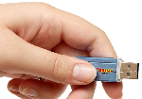




WidePoint’s CyberSecurity Practice
Identity & Information Assurance
Certified & Accredited Managed Services
  Authentication as a Service
      Multi-Factor
      Multi-modal
      Chip Management
  Federal Bridge Cross Certified
  Global Credential Validation
  Device Management Console
  Credential Services Provider for Federal interoperability
  Secure Hosting of Authoritative Sources
Identity & Information Assurance Consulting/ Credential Enabling
VAR for Identity & Information Assurance related products
Public Safety & Emergency Management Accountability
Attribute & Roles Management
  Raptor ID®
  FRAC – First Responder Access Credential
Evidence Tracking
  Condor®
Subject Matter Expertise in EMS, Fire, Law Enforcement, Public Health, Disaster Medicine
Network Security
Commercial Managed Services Leveraging ORC infrastructure
  Device Authentication & VPN Certificates
  iVAN Security Module, Full Duplex AES 256 bit Encryption Firmware Device
Identity & Information Assurance Consulting
Value Added Reseller for Identity & Information Assurance related products
TM

Slide 28







WidePoint’s Cybersecurity Benefits
Automation
  Automated, centralized user administration for processes
  Yields lower costs for helpdesk and hotline services
  Enhanced cost transparency for asset management
  Securely automate and manage portals
Increased productivity
  Automated provisioning of accounts in connected systems
  Ensure data quality by automatic synchronization
  Increase in user productivity through fewer passwords
Improved security
  Standardized security checks at the highest level for administrators
  Compliant with the NIST RBAC (Role-Based Access Control) standard
  Enterprise-wide transparency of access rights
  Quick revocation of access rights
  Precise monitoring of access rights
Always

Slide 29
How are you integrating Company Businesses to provide WidePoint solutions?
Integrated ID Mgmt, Mobile Device Mgmt (MDM) & Mobile Device Security MDS into single Chip management portal
  Leverage TEMS Customer-base of over 500K Managed Devices
  Expands channel for identity & attribute management solutions
  Provision an EMV payment application to existing or new credentials
Built on a Modular Infrastructure

Slide 30
Current Major Initiatives
U.S. Government External Certificate Authority (ECA) & Personal Identification Verification (PIV)
Transportation Workers Identity Credential (TWIC)
Non-Federal Issuer PIV-Interoperable (PIV-I)
E-Authentication/ Access Certificates for Electronic Services (ACES)
FRAC/ Public Safety Accountability: PA, MA, DE, RI, WV ……

Slide 31
Pending Initiatives
Healthcare Multi-Factor Authentication
  Drug Enforcement Agency (DEA) Regulations for controlled substances
  Electronic Health Records (EHR) - Meaningful Use/ Privacy Protection
  Centers for Medicaid & Medicare (CMS) Fraud Mitigation
Public Social Networking Security Portal
Extend State & Local Government Footprint

Slide 32









Key partners and new partners to achieve Strategic Direction & Corporate Goals?
Armed Forces Communications & Electronics Association
American Logistics Association
Association of Public-Safety Communications Officials
Federation for Identity & Cross-Credentialing Systems
Bell ID
Data Systems Analysts, Inc.
RSA Security
Axway Software
Thales

Slide 33


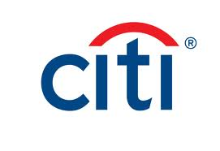



Potential Partnership/Channels
Eid Passport
IBM
Citi
Tyco
SNVC
MyComingle
TWD & Associates, Inc.

Slide 34








A Common Access Infrastructure
Currently over 20 million people have federally compliant credentials
Federal Government
Trading Partners & Allies
Public Safety & Healthcare
As this number grows, opportunities for efficiencies skyrocket !

Slide 35

























Customers
34 of Fortune 100 Companies
22 of Top 25 Federal Contractors
200+ Colleges & Universities
100+ Municipalities & Schools
100+ Private & Public Research Organizations
100+ Healthcare Organizations
40+ Banks & Financial Institutions
11 Airlines
Numerous Federal Agencies

Slide 36
200 Million Entity Campaign
 | 2013 | 2016 | 10-years
Potential Entity Universe | 2.2M | 15.2M | 200M
Potential Entity Value (Discounted) | $49M | $345M | $975M
WidePoint Market Share, Users (Discounted) | 850K | 4M | 60M
WidePoint Market Value, $ (Discounted) | $12M | $75M | $215M

Slide 37
Pipeline for 2013
Revenue | Funded | Unfunded | Initiatives
Managed Services | $ 4M | $ 3M | $ 3M ($20M)
VAR | $ 2M | $ 5M | $ 3M
REVENUE | $ 6M | $ 8M | $ 6M
PRE-TAX INCOME/ LOSS | $ 200K | $ 300K | $ 2M
Existing Funded Contract Work
Transportation Workers Identity Credentials
Navy Non-Personal Entity Credentials
Agency PIV (EPA, FTC, etc.)
Managed Validation for GSA

Slide 38
Managed Services Pricing
Program | Annual per user | Applicable to
Certificates & Token Management (high critical) | $90 - $125 | ECA Medium Hardware, FiXs/ NFI
Certificates & Token Management (medium critical) | $55 - $75 | PIV, NFI States, DoD Dependent/Vet, DoD Device IDs
Credentials/ Certificates only (customer issuer) | $1 - $25 | PIV MSO, TWIC/TTAC, DoD Dependent/Vet, E-Government, E-Citizen
Attribute/ Validation/ Translation/ Escrow/ Recovery & other related services | $1 - $25 | Monthly subscriptions per user base
Enterprise Pricing Available
Consulting & VAR Services Typically Fixed Priced Orders

